Slide 1
How to do on-line application?
Technical Support: sie@uibe.edu.cn
Notes:
此模板可用作相册的起始文件。

Slide 2
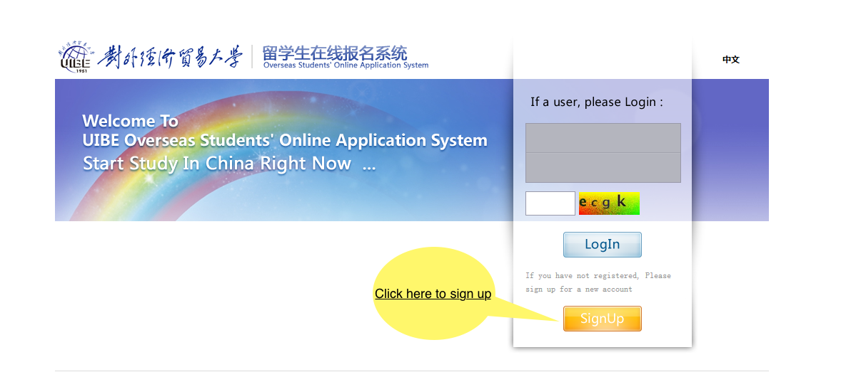
Technical Support: sie@uibe.edu.cn

Slide 3
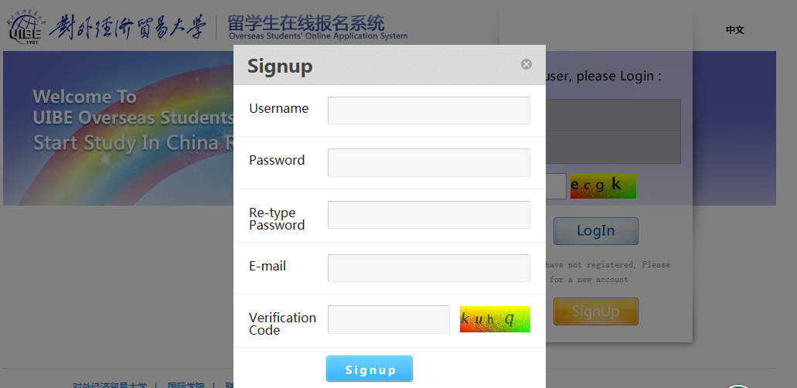
Technical Support: sie@uibe.edu.cn
Input your username and remember it
The email must be correct and valid!

Slide 4
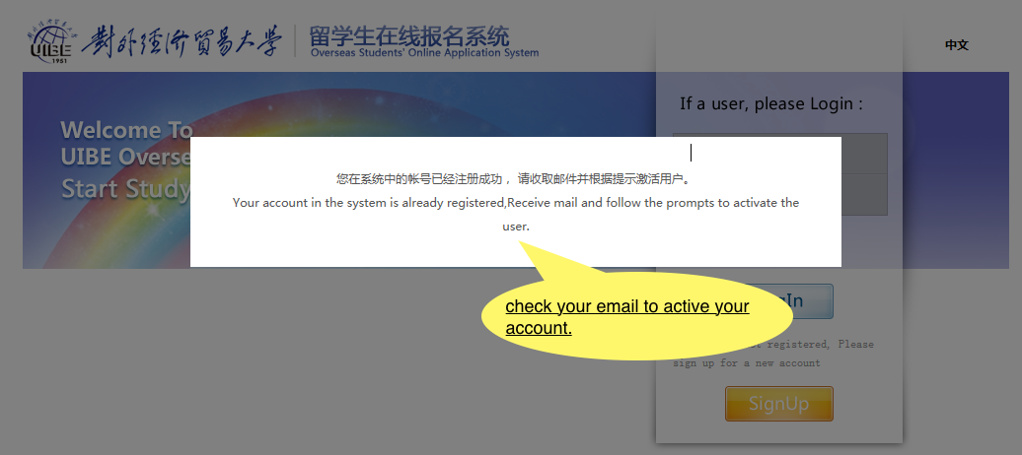
Technical Support: sie@uibe.edu.cn

Slide 5
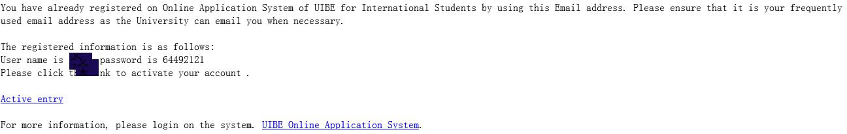
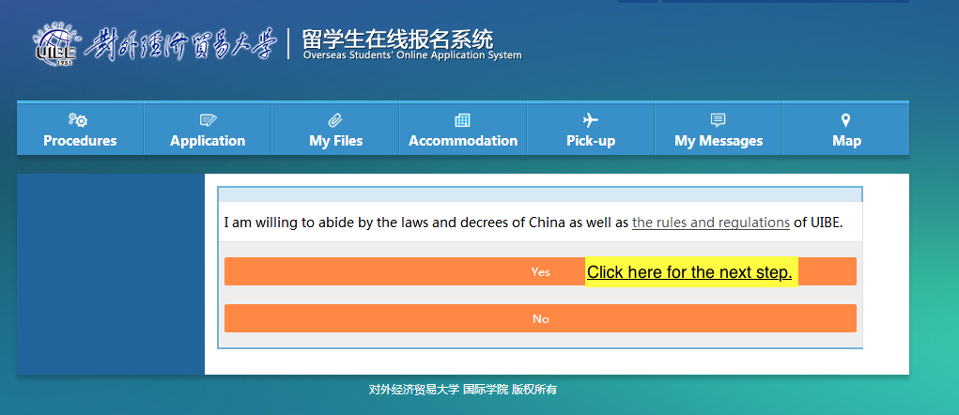
Click here to enter the system!
Technical Support: sie@uibe.edu.cn

Slide 6
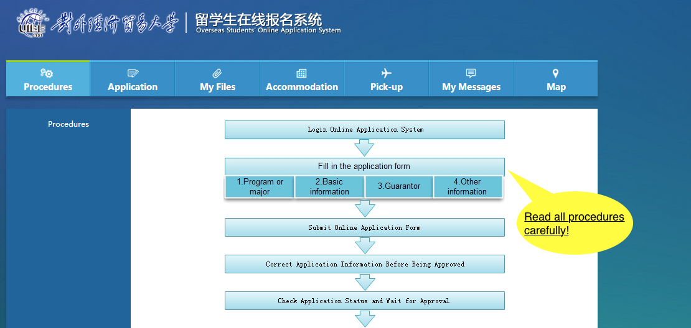
Technical Support: sie@uibe.edu.cn

Slide 7
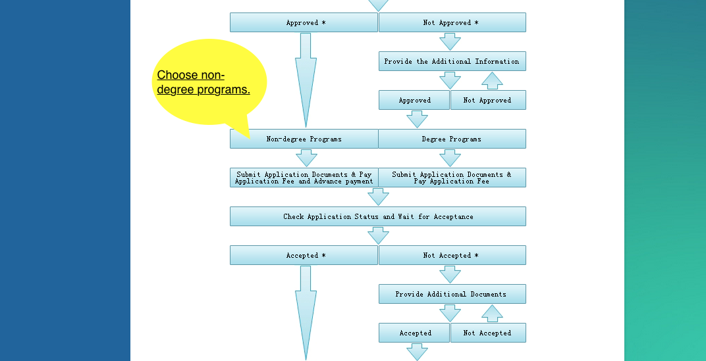
Technical Support: sie@uibe.edu.cn

Slide 8
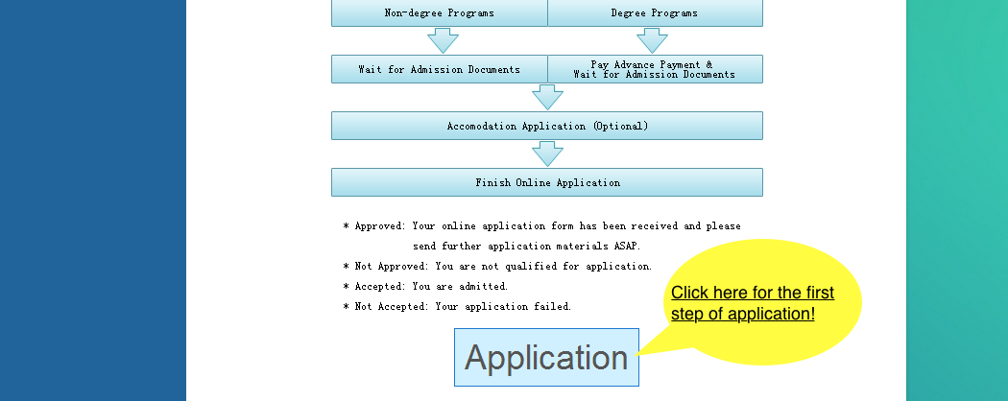
Technical Support: sie@uibe.edu.cn

Slide 9
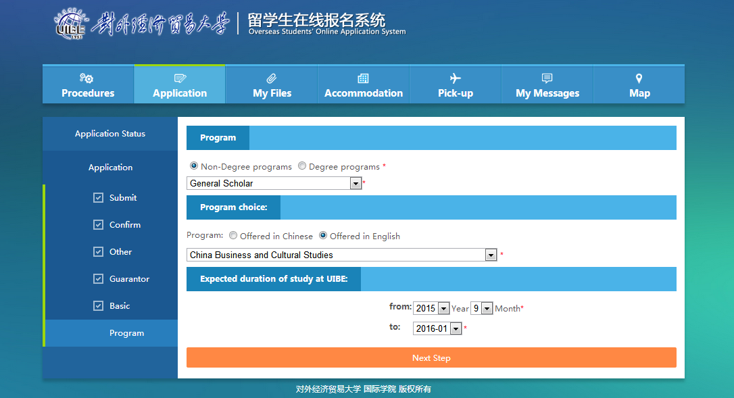
Technical Support: sie@uibe.edu.cn
All exchange students should choose “General Scholar”.
All exchange students should choose “Chinese Business and Cultural Studies”.
IMPORTANT！！！Choose your study period: one semester or one year. This would affect your visa type.

Slide 10
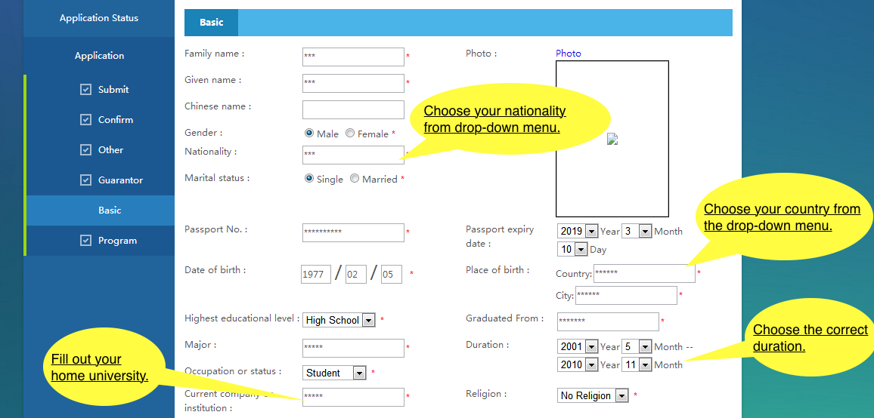

Slide 11
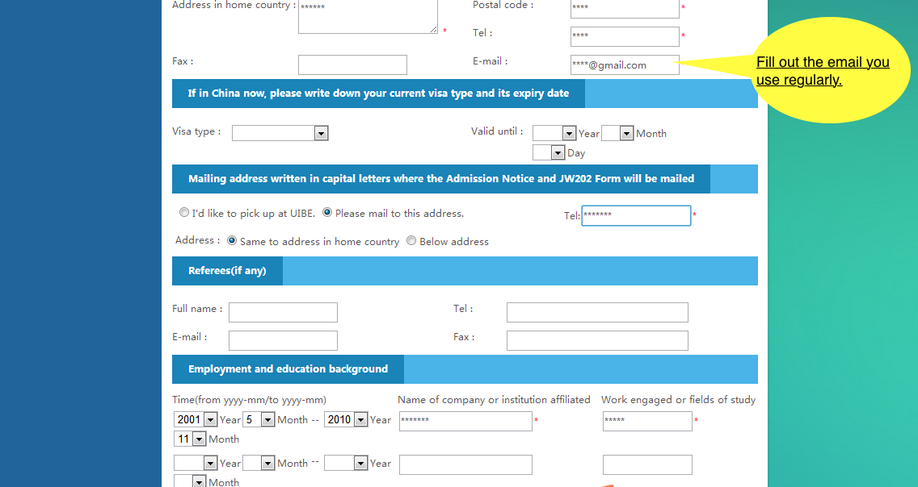
IMPORTANT!!!
Here please fill out ”GEEC”
Should be “8610-64492121”

Slide 12
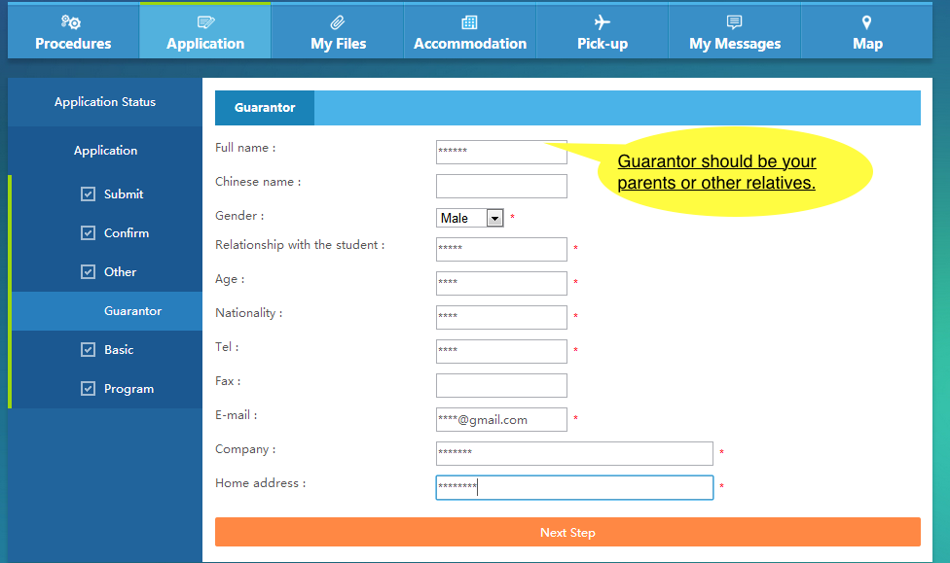
Technical Support: sie@uibe.edu.cn

Slide 13
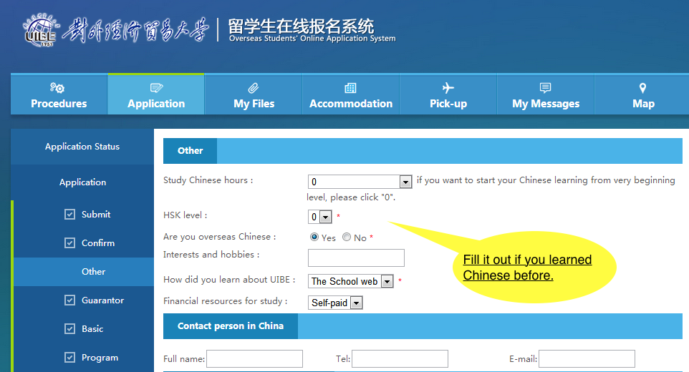
Technical Support: sie@uibe.edu.cn

Slide 14
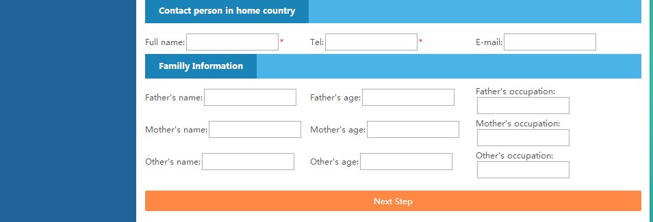
Technical Support: sie@uibe.edu.cn
Input your contact person in your home country for emergency.

Slide 15
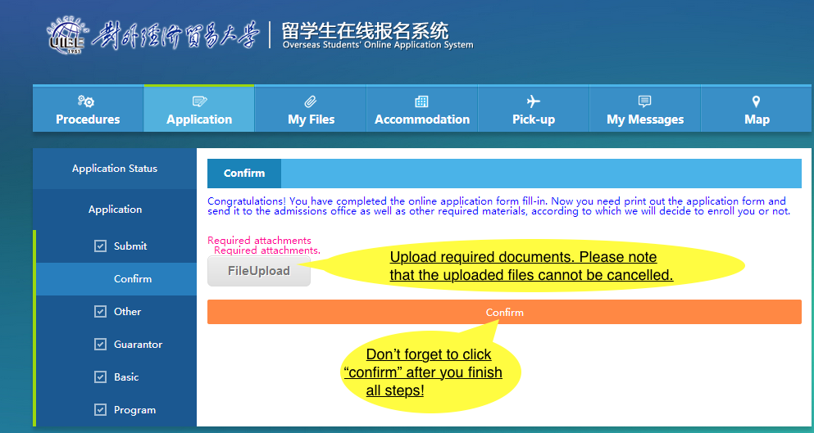
Technical Support: sie@uibe.edu.cn
MUST Submit a copy of transcript, your passport main page and the nomination letter from your home university.

Slide 16
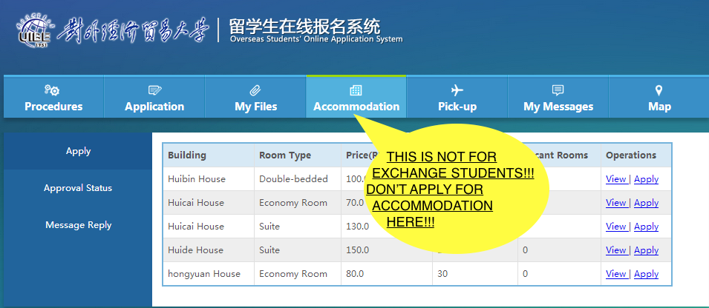
Technical Support: sie@uibe.edu.cn

Slide 17
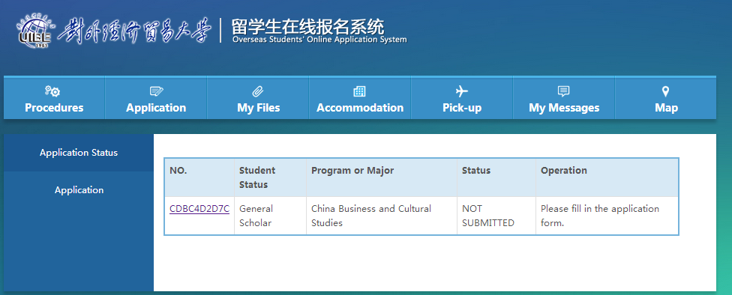
Technical Support: sie@uibe.edu.cn

Slide 18
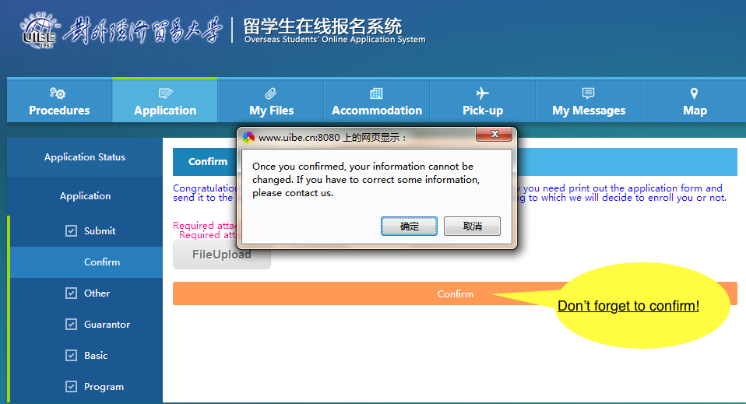
As an exchange student, you don’t have to pay neither application fee nor tuition if you are asked to do so.
Technical support: sie@uibe.edu.cn

